Slide 1
Wednesday, September 14, 2016
Write In Your Agenda:
Write In Your Monitoring Log:
CW:
Review Continental Drift vs. Plate Tectonics
Plotting the Evidence
HW:
None.
Response to Warm-Up:
Describe the Theory of Plate Tectonics. How does it differ from Wegener's Theory of Continental Drift?
You will need:
Pencil
Highlighter
Continental Drift Venn Diagram

Slide 2
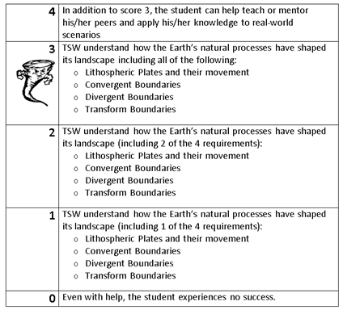
Learning Goal and Scale
TSW understand how the Earth’s natural processes have shaped its landscape (including Lithospheric Plates and their movement, Convergent, Divergent, and Transform boundary landforms).

Slide 3
https://www.youtube.com/watch?v=KCSJNBMOjJs

